Slide 1

Data Viz Workshop

Slide 2

Workshop Outline
What is a good Data Viz?
Data Collection Methods
Selecting the right chart
Intro to Matplotlib
Intro to Numpy
Project Walkthrough

Slide 3
Announcement - Competition
🌐 Topic: You can create a data visualization on a topic of your choice!
📆 Submission Deadline: 17th October
🖊️ Submission Process: To enter the competition, simply complete our Google Form with your data visualization. The submission form link will be posted on the Instagram page after the workshop.
🚀 Examples of data visualizations can be found @uwaterloodsc

Slide 4
Submission Guidelines
📚 Choose topics that are not controversial. Let's keep it inspiring and educational!
📁 Entry: Each submission should include a title page, three charts, description, and source code (can be copy-pasted to a Google Doc) to be considered.
🖊️ Description: Explain each data visualization you've created. What story do your charts tell?

Slide 5

What is a Data Visualization?
Data Viz is the graphical representation of data to help people understand, interpret, and make sense of complex information
It helps:
Simplify complex information
Identify patterns and trends
Make decisions

Slide 6
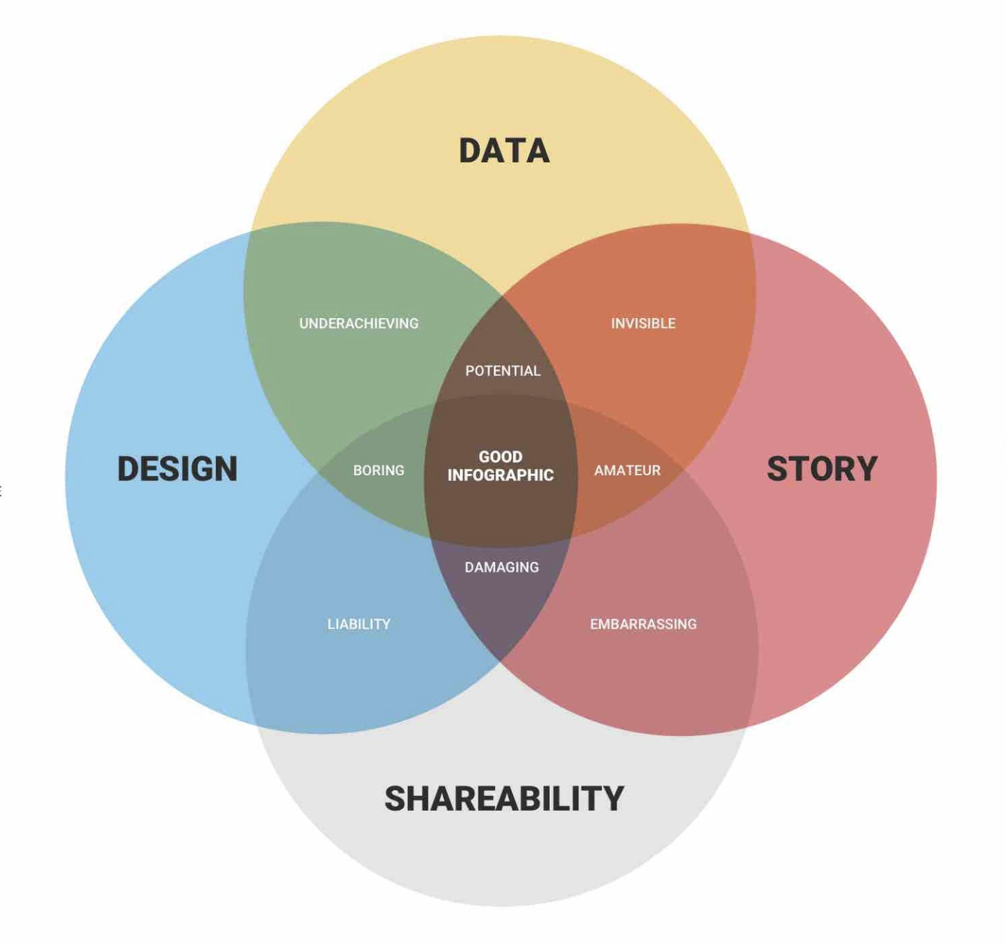
Key to a Good Data Visualization
Clarity
Relevance
Accuracy
Simplicity
Chart Type
Ethical Consideration

Slide 7

Steps to creating a Data Visualization
1. Gather and Prepare your data
2. Clean the Data
3. Select the right chart types
4. Create your visualization
5. Label and annotate

Slide 8


Gathering Data
Data Collection Methods
Data Cleanup
Data Exploration

Slide 9




Data Collection Methods
Manual Entry
Surveys, Small datasets
2. Web Scraping
E-commerce websites, News Articles, Job Market
3. APIs
X, Meta, Google Maps, OpenWeatherMap
4. Data Repositories
Kaggle, GitHub, Data.gov

Slide 10

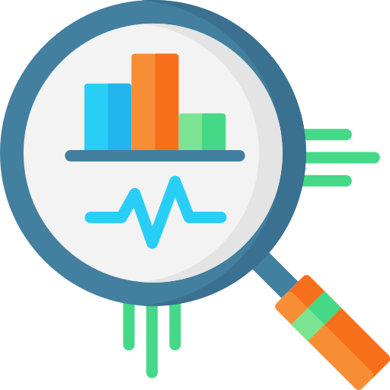
Data Cleanup & Exploration
Missing values, NaNs, outliers
Pandas, NumPy
2. Data Transformations
Aggregations, reshaping, normalization
3. Statistics
Numerical: mean, median, min, max
Categorical: frequencies of unique categories

Slide 11
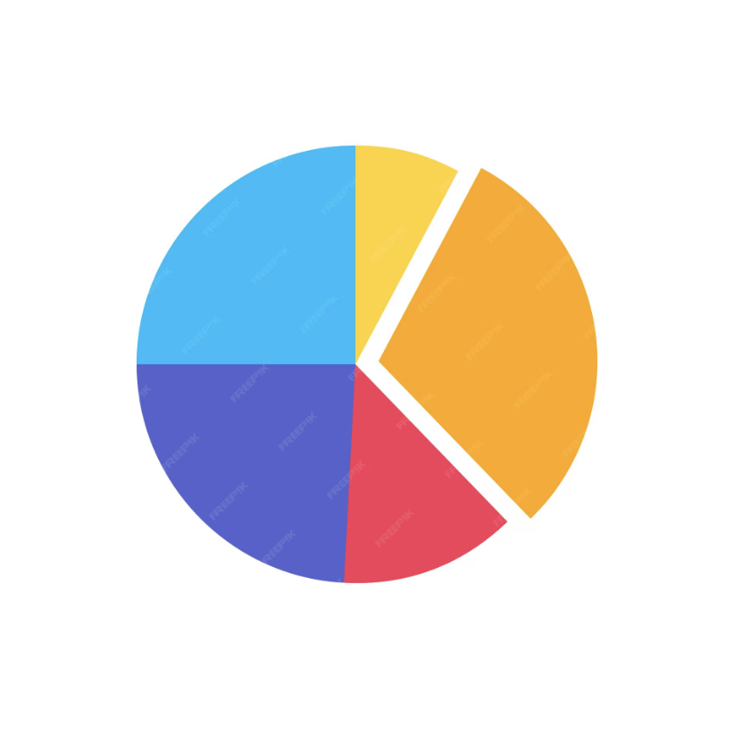
Selecting the right charts
Pie Chart
Suitable for Showing the composition of a whole in terms of parts or percentages
Example data: Percentage of Students in each Faculty

Slide 12
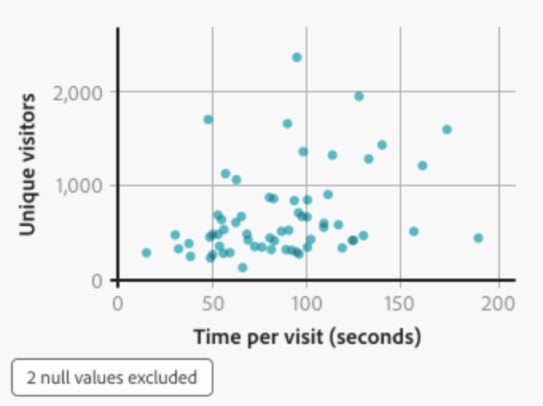
Selecting the right charts
2. Scatterplot
Suitable for: Visualizing the relationship between two continuous variables
Example data: Height vs. weight, age vs. income, exam scores vs. study hours.

Slide 13
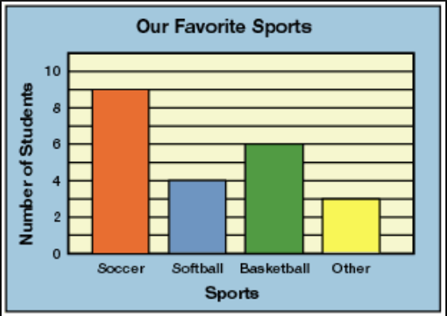
Selecting the right charts
3. Bar Chart
Comparing categories or values across different groups
Example: population by city, student performance by subject.

Slide 14
Matplotlib Introduction
Matplotlib, arguably the most popular graphing and data visualization module for Python
Creates: static, animated and interactive visualization
Easy to use!

Slide 15

Matplotlib
Installation:
Before you start using Matplotlib, make sure you have it installed. You can install it using pip if you don't already have it

Slide 16

Matplotlib
Importing Matplotlib:
Import Matplotlib in your Python script or Jupyter Notebook:

Slide 17
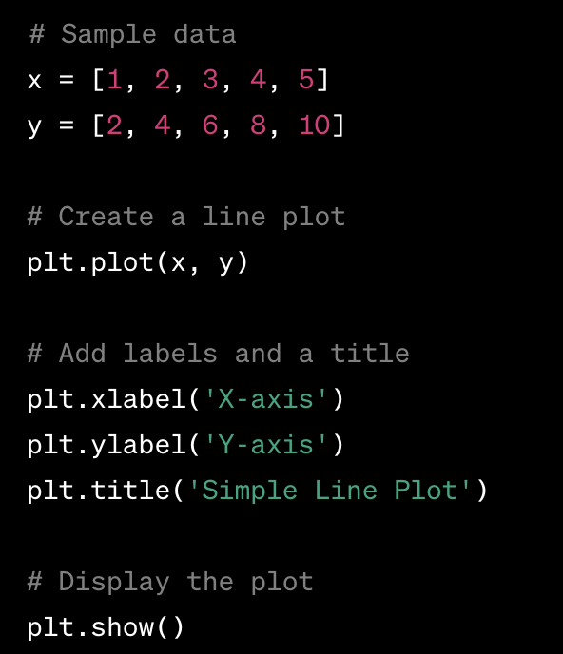
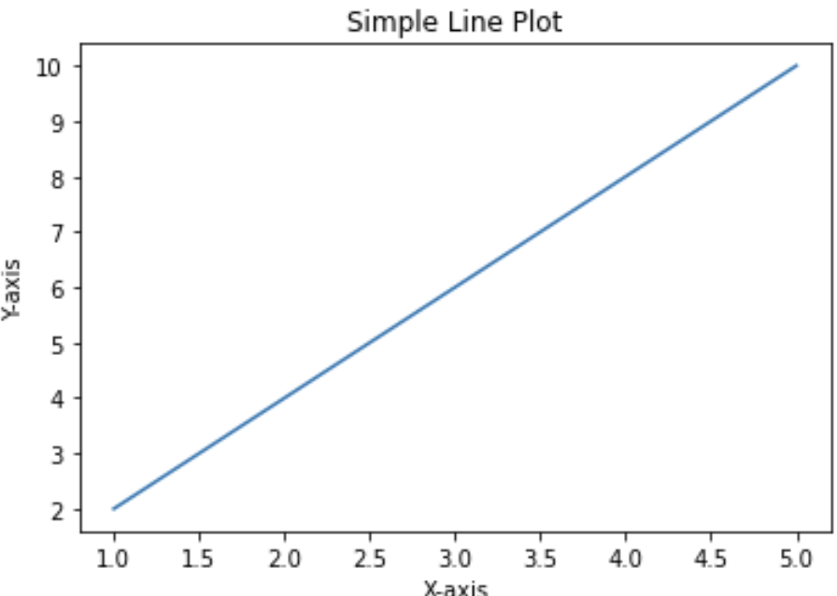
Matplotlib
Basic Plot:
Let's create a simple line plot.
Here's an example:

Slide 18
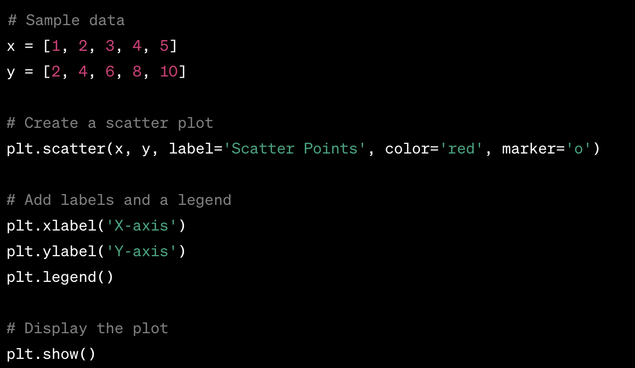
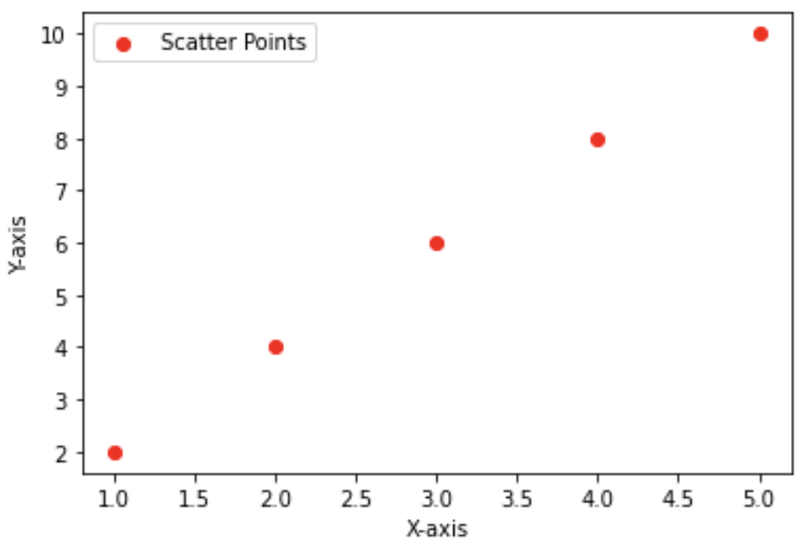
Matplotlib
Scatter Plot:
You can also create scatter plots using plt.scatter():

Slide 19
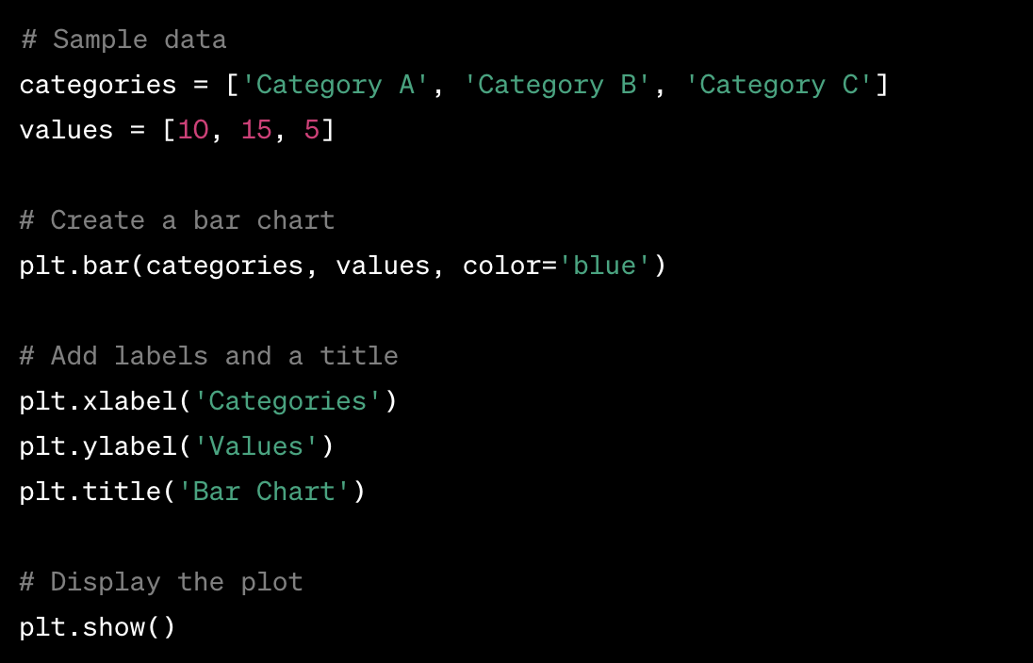
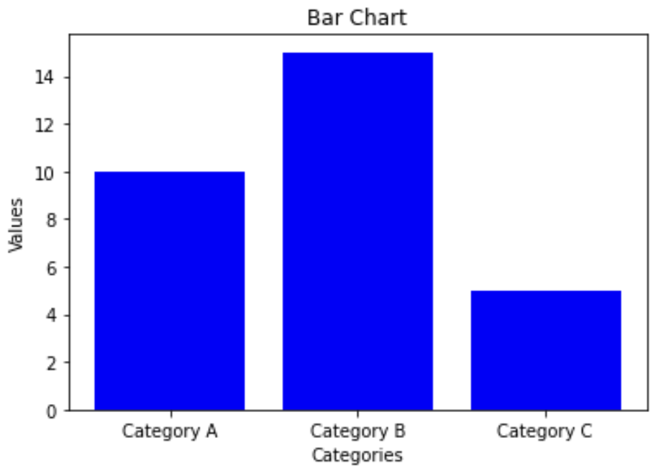
Matplotlib
Bar Chart:
To create a bar chart, you can use plt.bar():

Slide 20

Matplotlib
Saving Plots:
You can save your plots as image files using plt.savefig():

Slide 21
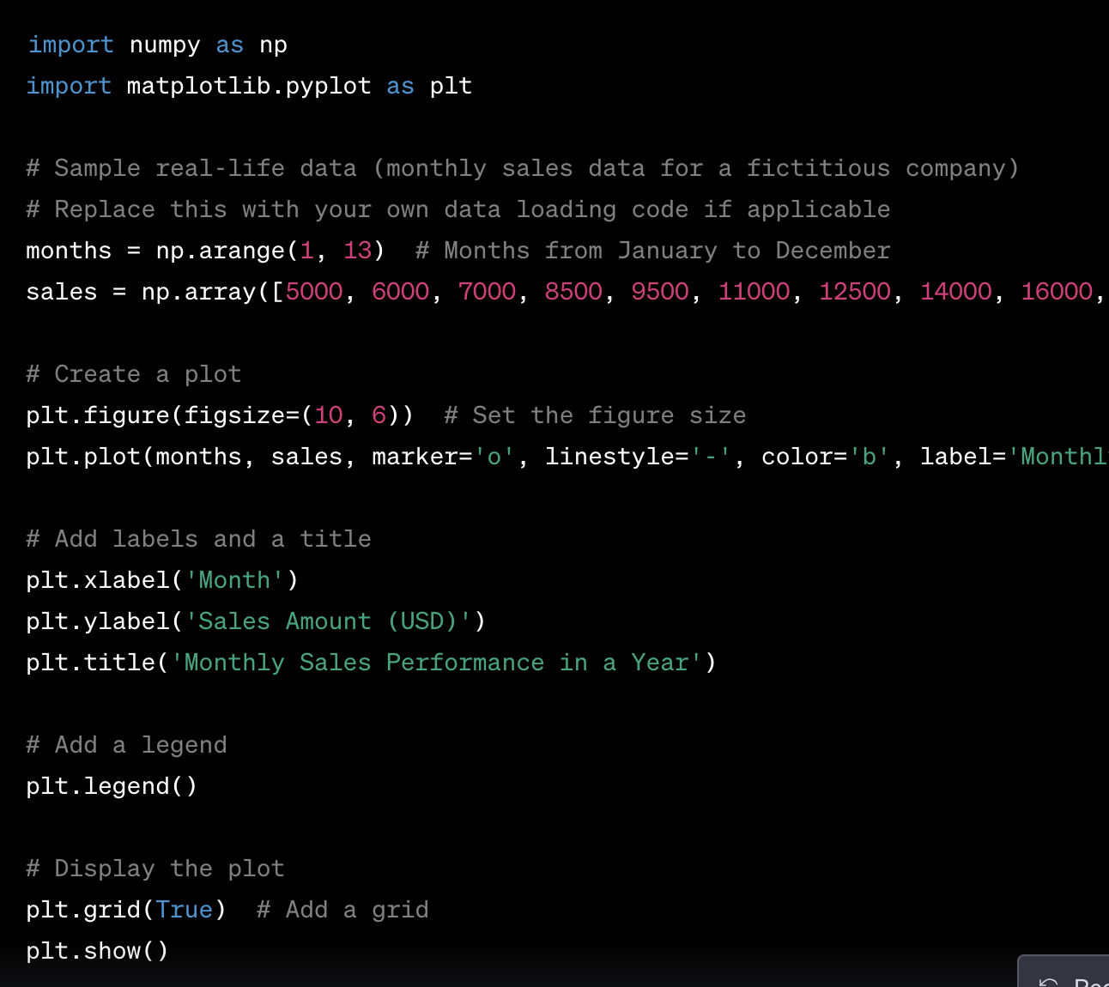
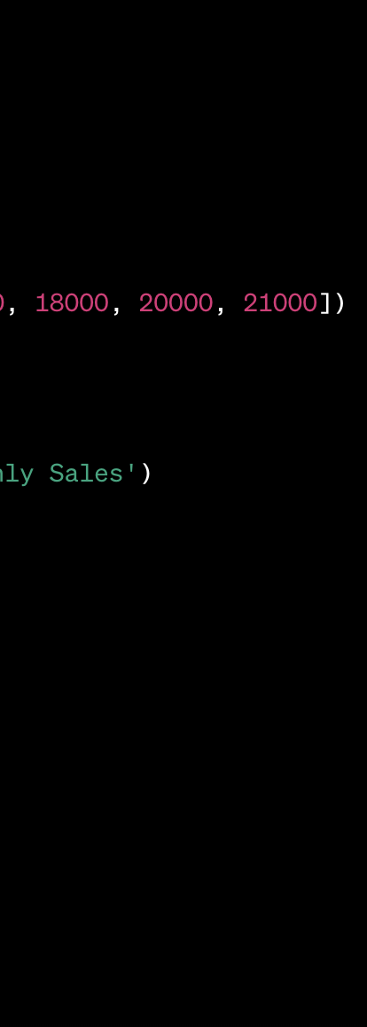
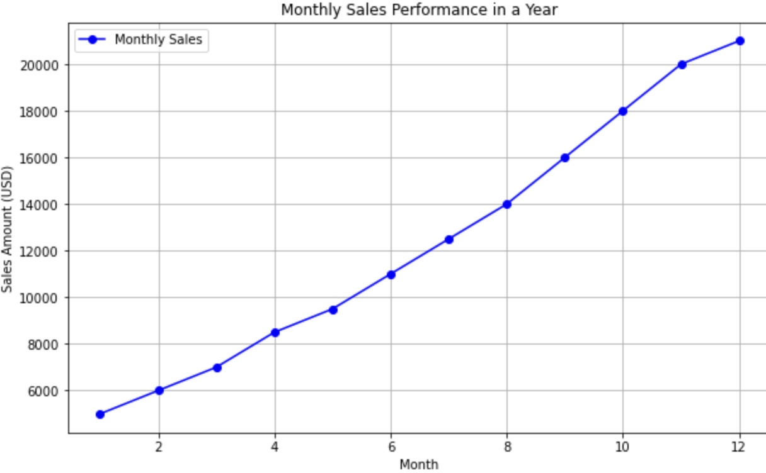
Matplotlib
Plotting numpy array

Slide 22
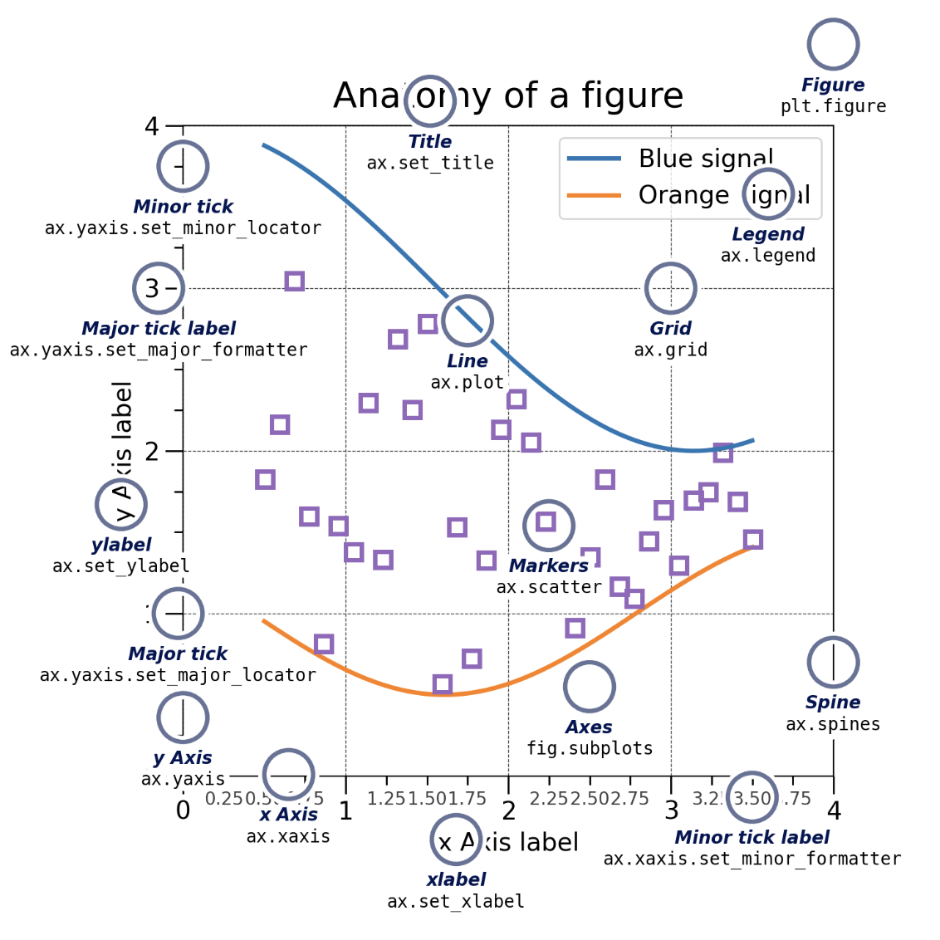
Matplotlib
Quick review:
Find out more: https://matplotlib.org/stable/
Notes:
Set_minor_locator, set_major_Formatter, fig.subplots, ax.grid,

Slide 23
What is NumPy?
NumPy (Numerical Python) is a library for fast, efficient multidimensional arrays and array processing routines.
Numpy offers a single basic data structure: an N-dimensional array type called ndarray : collection of items of the same type.
Other numpy data structures : np.matrix

Slide 24
NumPy : NDARRAY Object
There are a couple of essential ndarray fields:
dtype: strict type of the object in ndarray
ndim: # of dimensions of the ndarray (>= 1).
shape: returns a tuple consisting of array dimensions. & can be used to resize the array. Order is important!

Slide 25
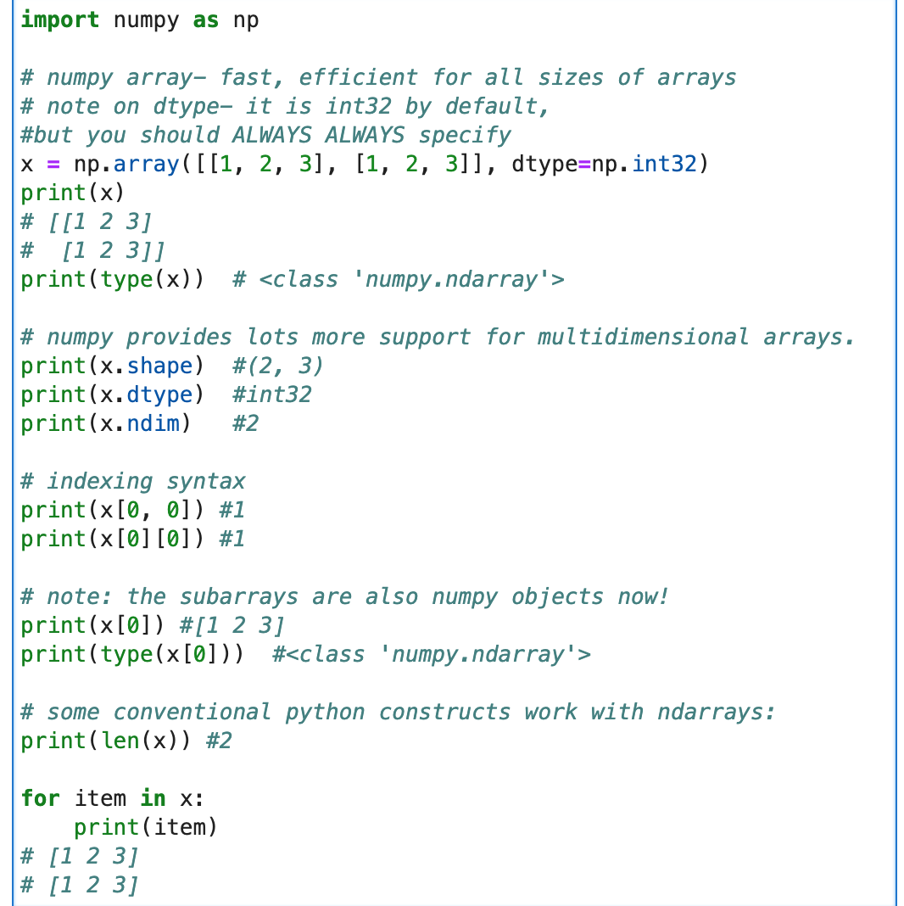
Example :

Slide 26
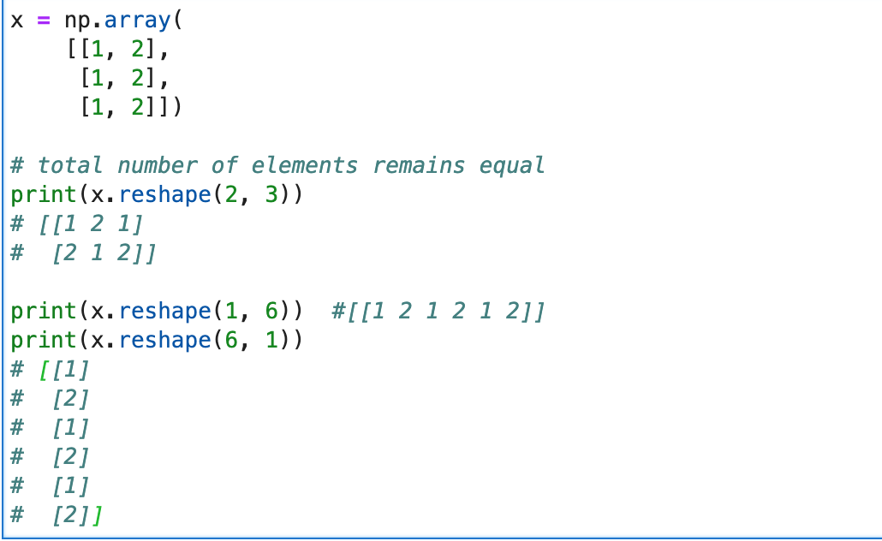
NumPy : Array Attributes
Reshape operation :
changes the size of the array but the new shape could rearrange elements in potentially unintended ways, so be careful!

Slide 27
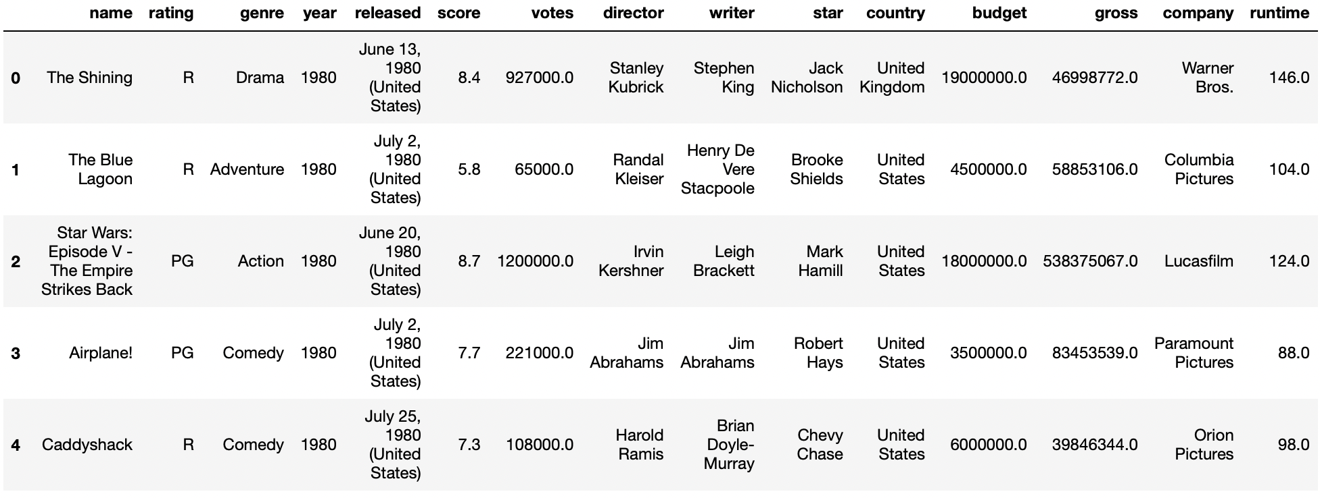
Project Walkthrough - Dataset
In this project, I have used data on the movie industry from 1980-2016. I used Matplotlib to visualize and compare characteristics of different movies.
Dataset - “https://www.kaggle.com/datasets/danielgrijalvas/movies”
First five rows of the dataset -

Slide 28
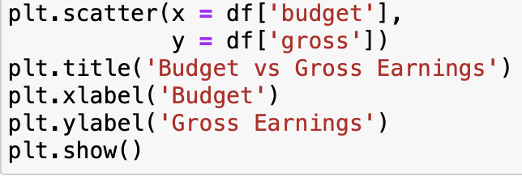
Budget vs Gross Earnings - Using Scatter Plot

Slide 29
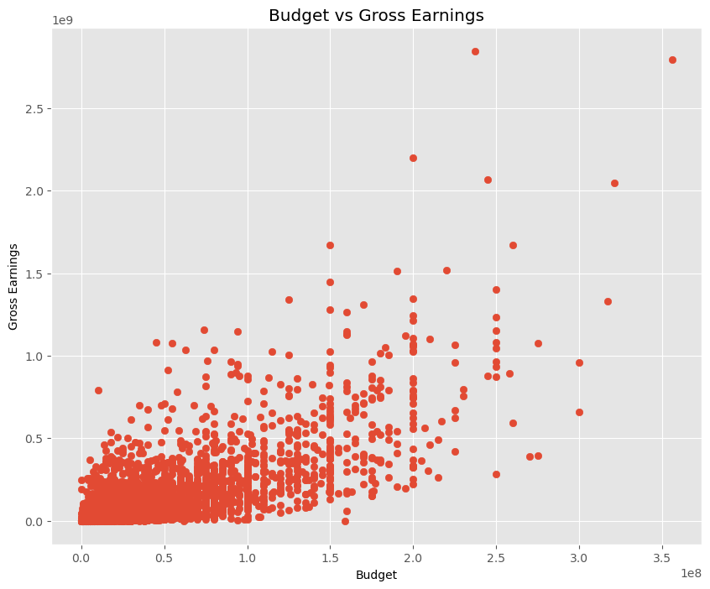
Budget vs Gross Earnings - Using Scatter Plot

Slide 30
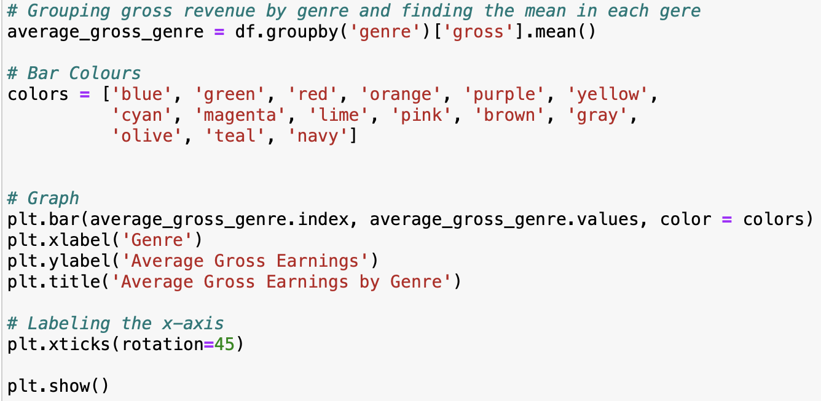
Average Gross Earnings by Genre- Using Bar Chart

Slide 31
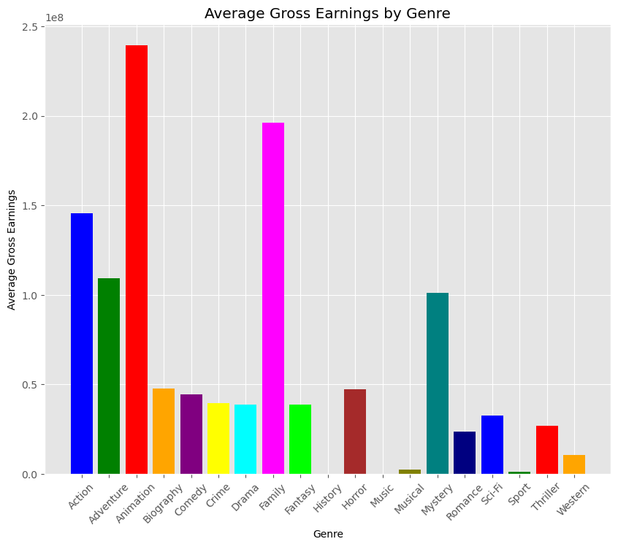

Slide 32
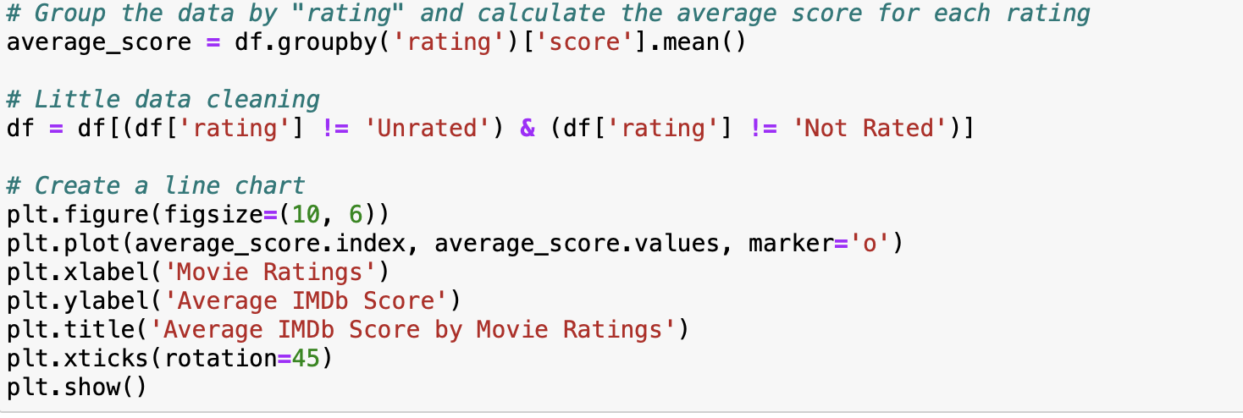
Average IMDb Score by Rating - Using Line Chart

Slide 33
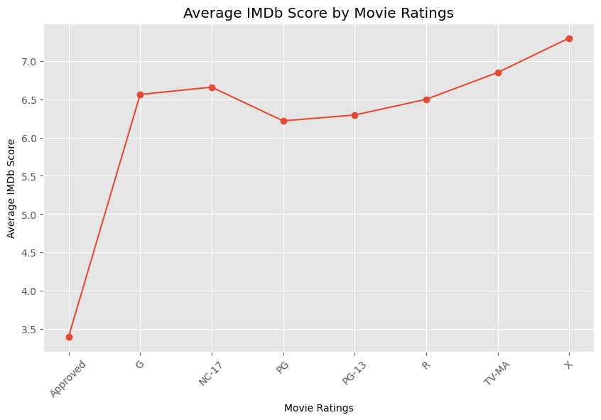

Slide 34
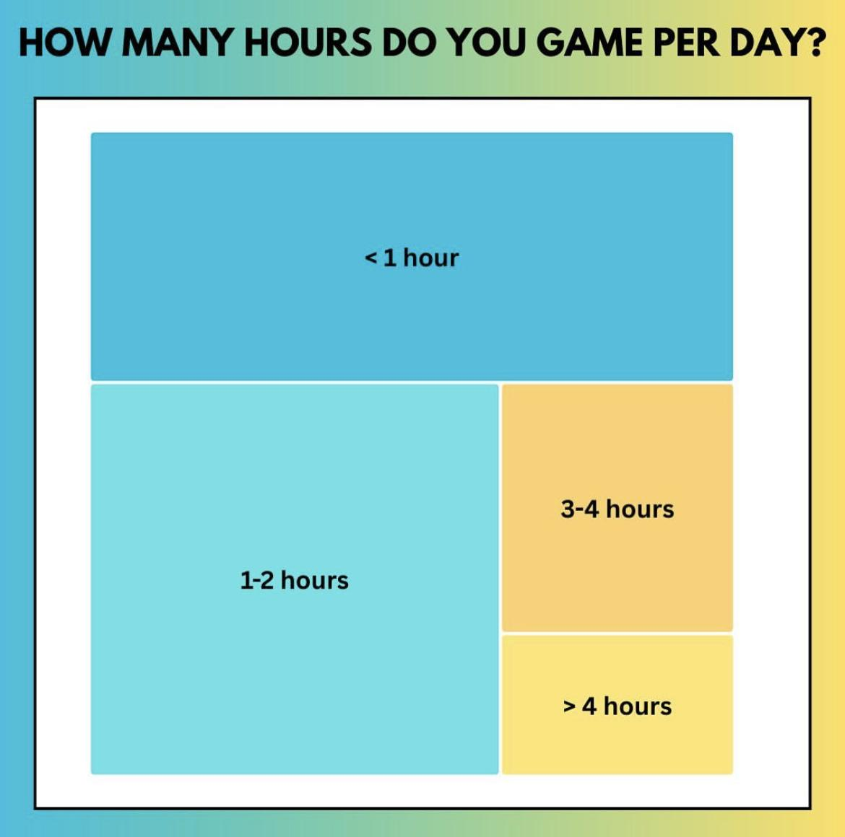
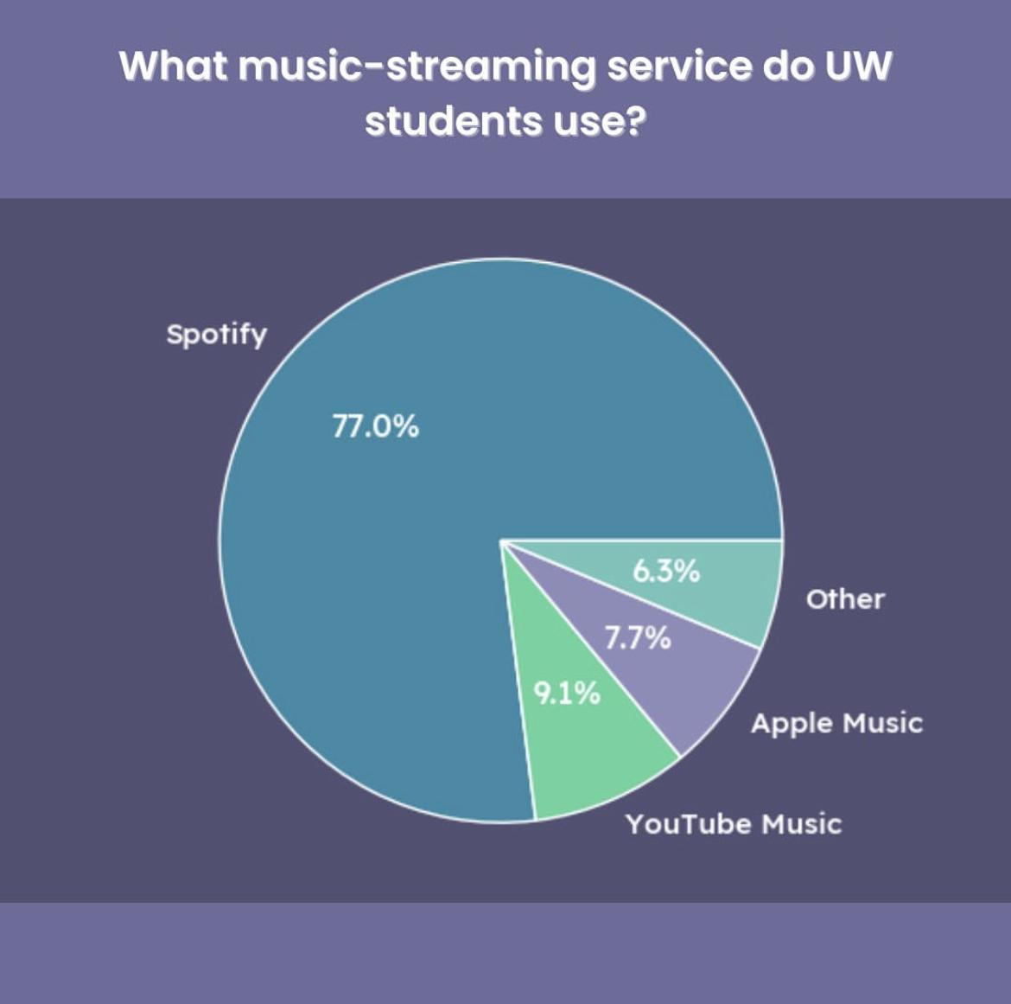
Examples

Slide 35
Thank you!

Slide 36
Q & A

